Slide 1

LIBRARY AND DOCUMENTATION DEPARTMENT
For CHROME
PROXY SETTINGS
kutuphane@agu.edu.tr

Slide 2
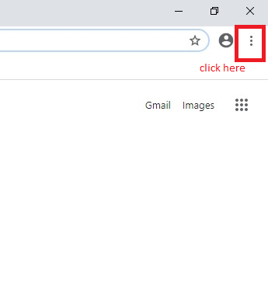
OPEN YOUR GOOGLE CHROME AND CLICK MARKED LOCATION.

Slide 3
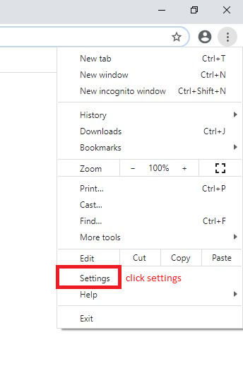

Slide 4
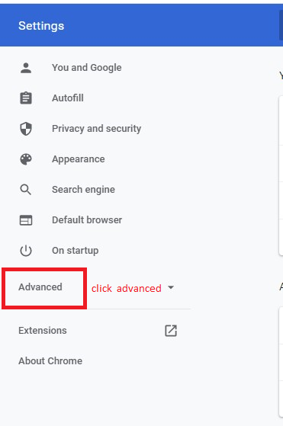

Slide 5
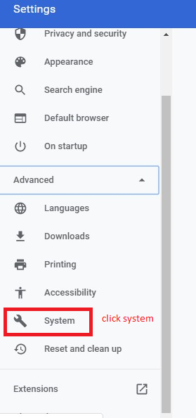

Slide 6
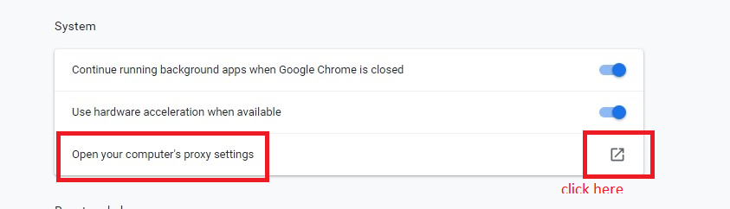

Slide 7
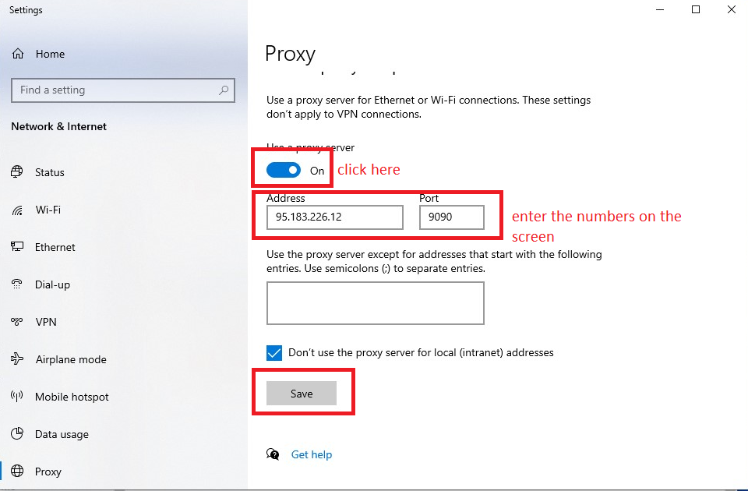

Slide 8
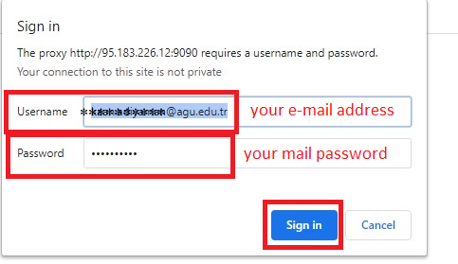

Slide 9

We wish you healthy days.

