Slide 1
LIBRARY AND DOCUMENTATION DEPARTMENT
For MOZILLA FIREFOX
PROXY SETTINGS
kutuphane@agu.edu.tr

Slide 2
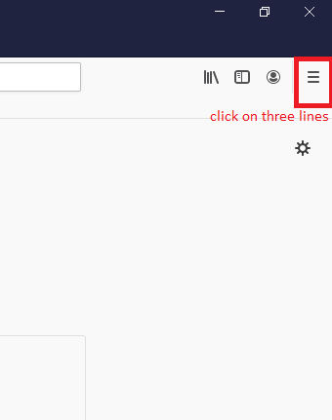
OPEN YOUR MOZILLA FIREFOX AND CLICK MARKED LOCATION.

Slide 3
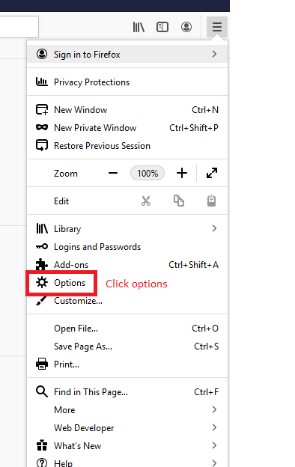

Slide 4
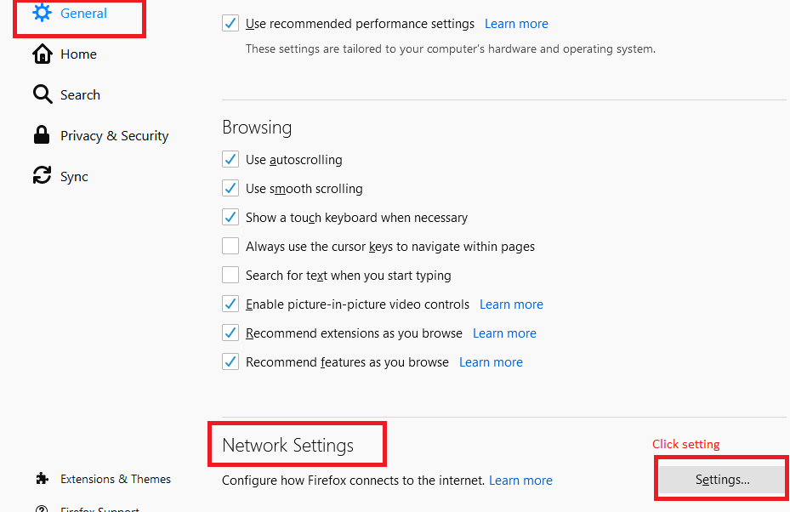

Slide 5
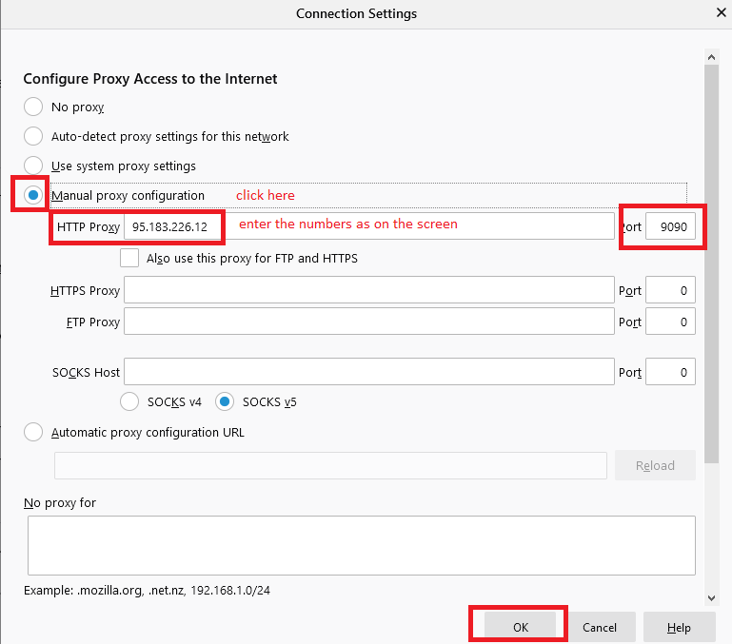

Slide 7
We wish you healthy days.

