Slide 1

LIBRARY AND DOCUMENTATION DEPARTMENT
For YANDEX
PROXY SETTINGS
kutuphane@agu.edu.tr

Slide 2
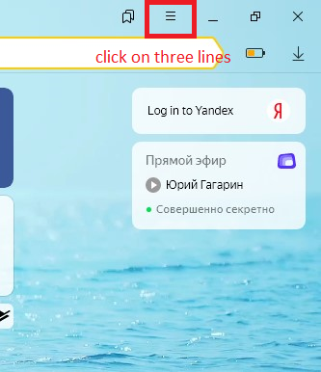
OPEN YOUR YANDEX AND CLICK MARKED LOCATION.

Slide 3
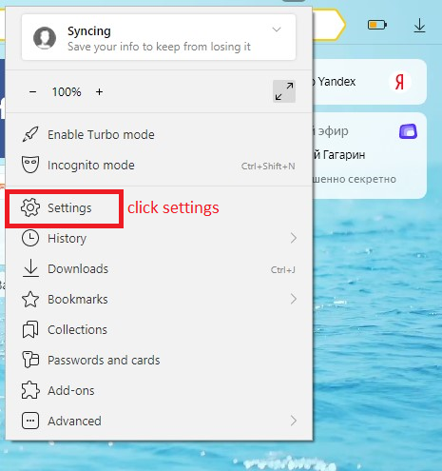

Slide 4
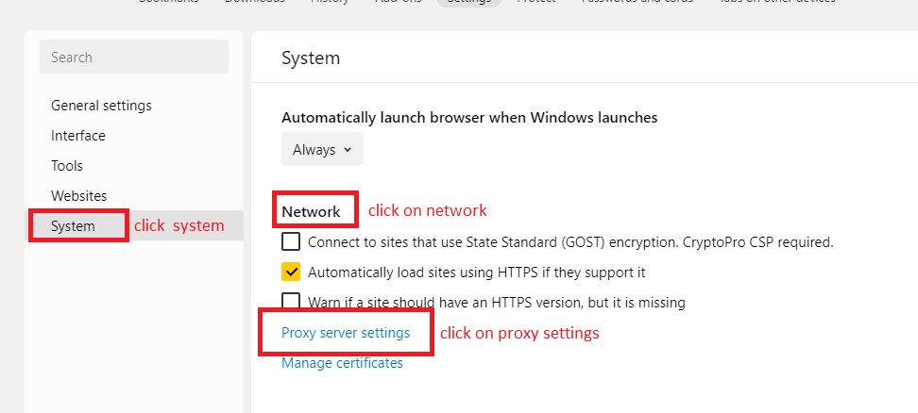

Slide 5
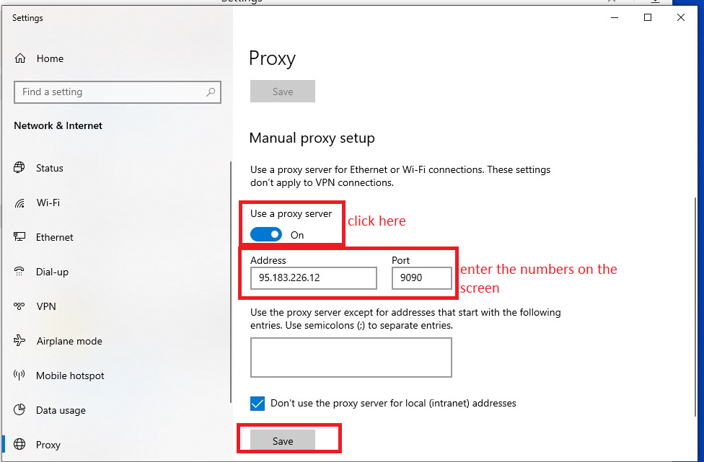

Slide 6
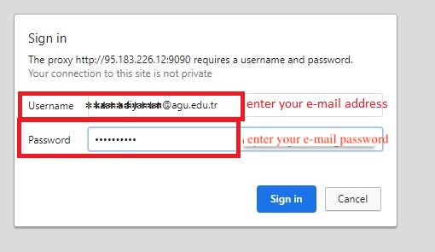

Slide 7

We wish you healthy days.

